Slide 1
Unit 1:Contents
1 | Bitwise operators
2 | Special Operators
3 | The ternary operator
4 | Precedence of Arithmetic operators
5 | Implicit and explicit Type conversions
6 | Operator precedence and associativity
Prepared By Dr.Vandana B.S

Slide 2
Bitwise Operators
All the data stored in computer memory are in sequences of bits (0’s and 1’s).
Some applications require the manipulation of these bits.
Manipulation of individual bits is carried out in machine language or assembly language.
‘C’ provides six operators to perform bitwise operations.
These operators work only with int and char data-types.

Slide 3
Bitwise Operators
They cannot be used with floating point numbers.
The six bitwise operators in ‘C’ are
OPERATOR | MEANING
& | Bitwise AND
| | Bitwise OR
^ | Bitwise exclusive OR
~ | 1’s complement
<< | Shift left
>> | Shift right

Slide 4
Bitwise AND(&)
It takes two operands, b1 and b2.
Result of bitwise AND is 1 when both bits are 1, otherwise it is 0.
Decimal | Binary
0 | 000
1 | 001
2 | 010
3 | 011
4 | 100
5 | 101
6 | 110
7 | 111
b1 | b2 | b1&b2
0 | 0 | 0
0 | 1 | 0
1 | 0 | 0
1 | 1 | 1

Slide 5
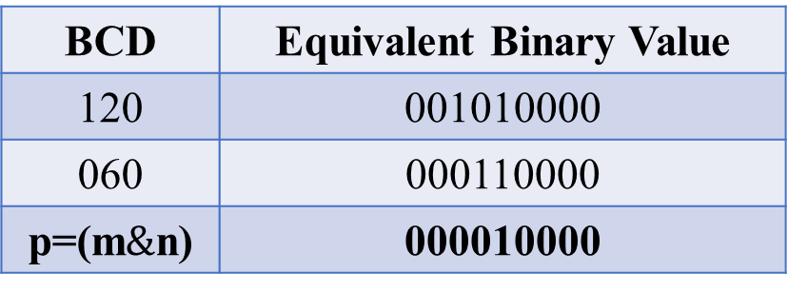
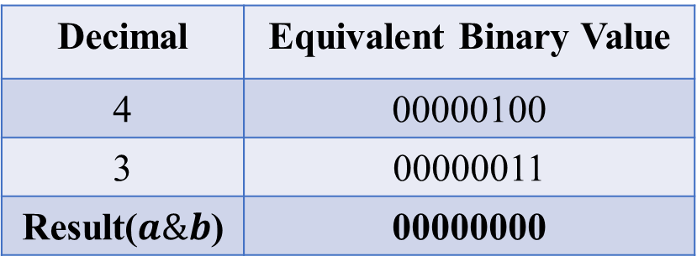
Bitwise AND(&)
EX1:Considering normal binary digits.int a = 4, b = 3;
Decimal | Equivalent Binary Value
4 | 00000100
3 | 00000011
Result($a\&b$) | 00000000
EX2: Considering BCD (Binary Coded Decimal). int m = 120, n = 060,
What is p;
BCD | Equivalent Binary Value
120 | 001010000
060 | 000110000
p=(m$\&$n) | 000010000

Slide 6
Bitwise OR(|)
Result of bitwise OR is 1 when one of the bits is 1, otherwise (when both bits are 0s) it is zero.
b1 | b2 | b1&b2
0 | 0 | 0
0 | 1 | 1
1 | 0 | 1
1 | 1 | 1

Slide 7
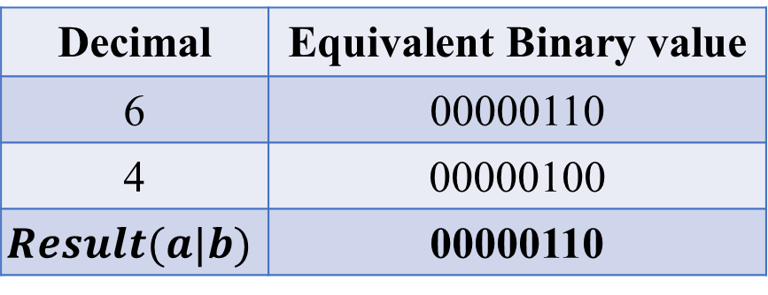
Bitwise OR(|)
EX1:Considering normal binary digits.int a = 6, b = 4;
Decimal | Equivalent Binary value
6 | 00000110
4 | 00000100
$$Result(a|b)$$ | 00000110
EX2: Considering BCD (Binary Coded Decimal). int m = 340, n = 723,
What is p;
BCD | Equivalent Binary value
340 | 011100000
723 | 111010011
p=(m|n) | 111110011

Slide 8
Bitwise XOR(^)
Result of bitwise XOR is 1 if the bits are different (1 and 0 or 0 and 1), otherwise (when both bits are 0’s and both bits are 1’s) it is zero.
b1 | b2 | b1^b2
0 | 0 | 0
0 | 1 | 1
1 | 0 | 1
1 | 1 | 0

Slide 9
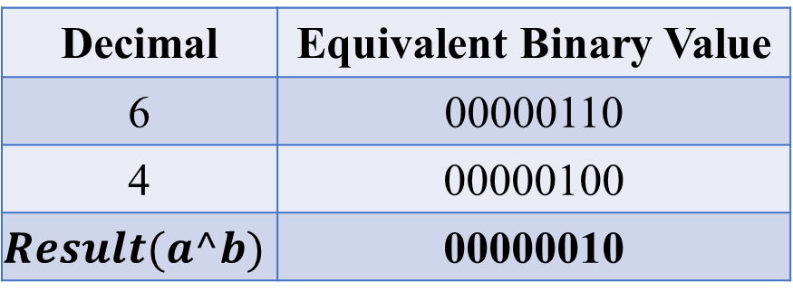
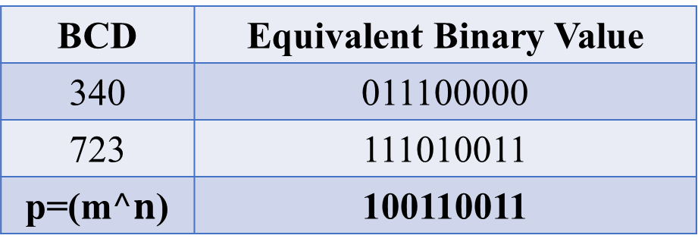
Bitwise XOR(^)
EX1:Considering normal binary digits.int a = 6, b = 4;
Decimal | Equivalent Binary Value
6 | 00000110
4 | 00000100
$$Result(a^b)$$ | 00000010
EX2: Considering BCD (Binary Coded Decimal).int m = 340, n = 723,
What is p;
BCD | Equivalent Binary Value
340 | 011100000
723 | 111010011
p=(m$^n$) | 100110011

Slide 10
One’s Complement (~)
The bitwise complement operator is a unary operator which reverses the state of each bit within an integer or character.
Each ‘zero’ get changed to ‘one’ and each ‘one’ gets changed to ‘zero’.
int b = 12; // 1100 (in binary form)
int a = ~b; // 0011

Slide 11
Left Shift Operator and Right Shift Operator << and >>
The left shift operator << shifts the bits to the left
The right shift operator >> shifts the bits to the right.
Syntax:
variable | shift operator | no. of bits
Examples: m >> 2
n << 1
Number of bits to be shifted
Shift operator
Variable holding int or char data type

Slide 12
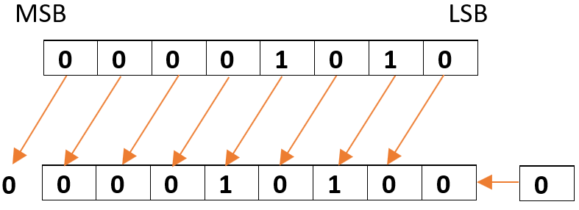
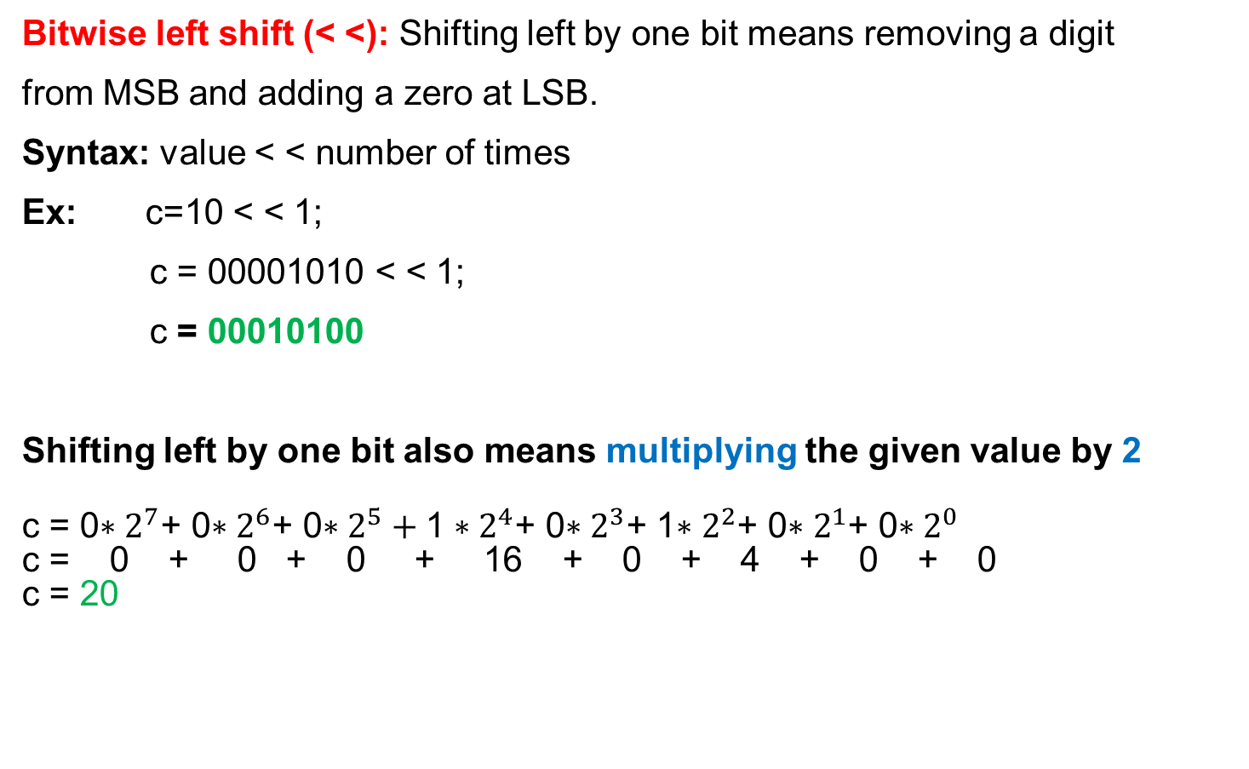
Left Shift Operator and Right Shift Operator << and >>
Bitwise left shift (< <): Shifting left by one bit means removing a digit
from MSB and adding a zero at LSB.
Syntax: value < < number of times
Ex: c=10 < < 1;
c = 00001010 < < 1;
c = 00010100
Shifting left by one bit also means multiplying the given value by 2
c = 0$∗2^{7}$+ 0$∗2^{6}$+ 0$∗2^{5}+\text{1}∗2^{4}$+ 0$∗2^{3}$+ 1$∗2^{2}$+ 0$∗2^{1}$+ 0$∗2^{0}$
c = 0 + 0 + 0 + 16 + 0 + 4 + 0 + 0
c = 20

Slide 13
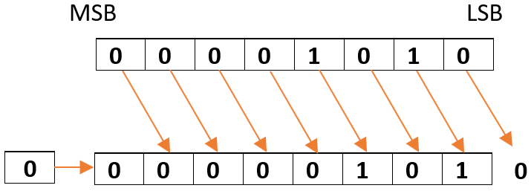
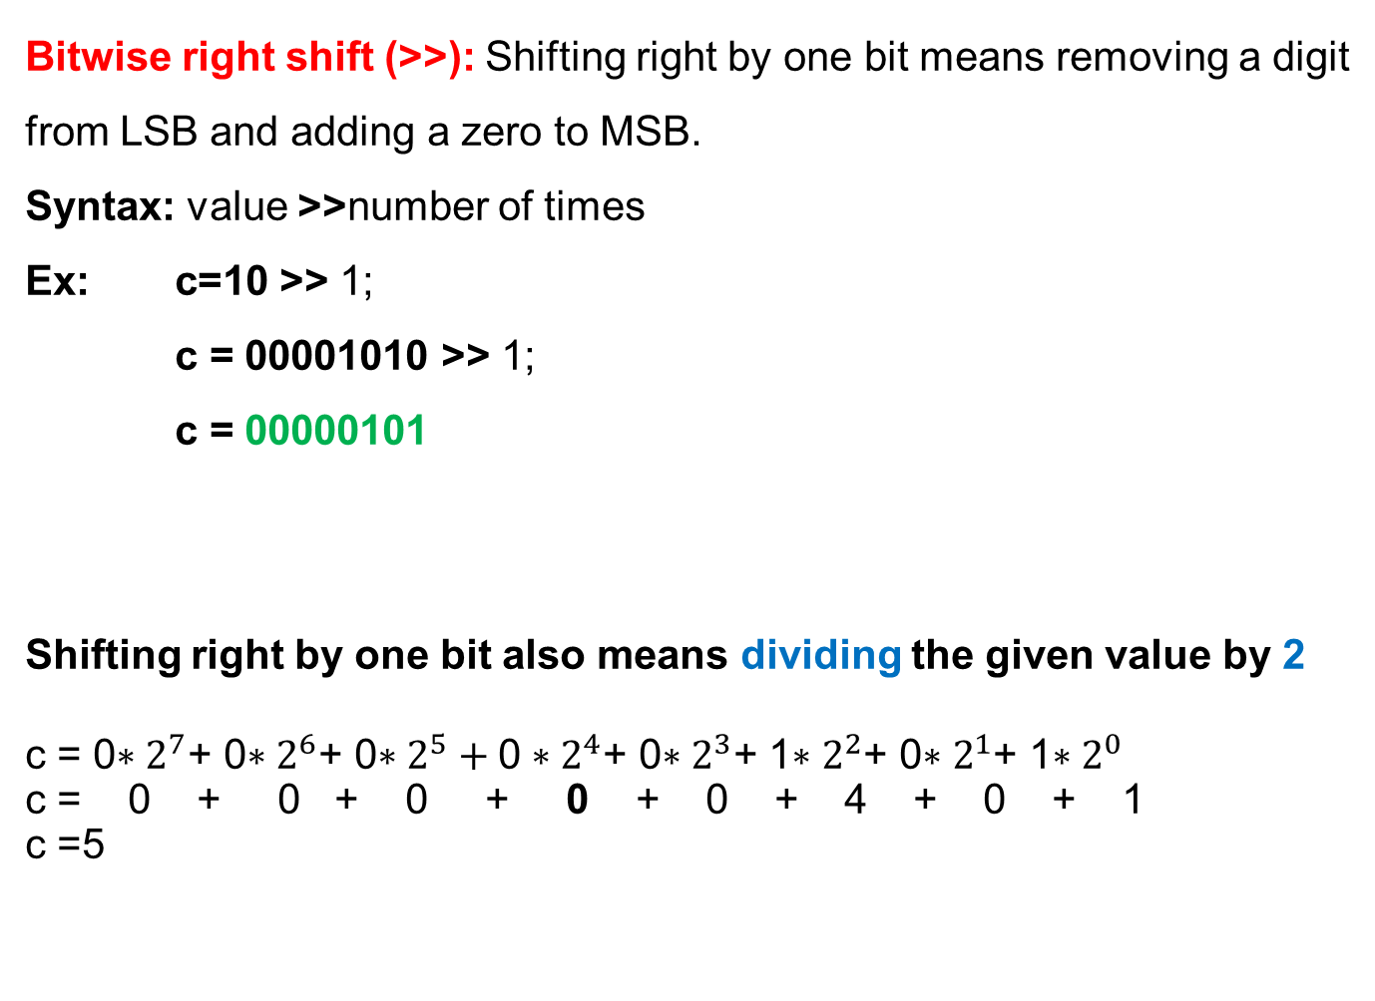
Bitwise right shift (>>): Shifting right by one bit means removing a digit
from LSB and adding a zero to MSB.
Syntax: value >>number of times
Ex: c=10 >> 1;
c = 00001010 >> 1;
c = 00000101
Shifting right by one bit also means dividing the given value by 2
c = 0$∗2^{7}$+ 0$∗2^{6}$+ 0$∗2^{5}+\text{0}∗2^{4}$+ 0$∗2^{3}$+ 1$∗2^{2}$+ 0$∗2^{1}$+ 1$∗2^{0}$
c = 0 + 0 + 0 + 0 + 0 + 4 + 0 + 1
c =5

Slide 14
Left Shift Operator and Right Shift Operator << and >>
Consider an integer variable a = 32
Example for bitwise left shifting:a << 2
32 | 0 | 0 | 1 | 0 | 0 | 0 | 0 | 0
128 | 1 | 0 | 0 | 0 | 0 | 0 | 0 | 0
Example for bitwise right shifting:a >> 2
32 | 0 | 0 | 1 | 0 | 0 | 0 | 0 | 0
8 | 0 | 0 | 0 | 0 | 1 | 0 | 0 | 0

Slide 15
/*** Program To Illustrate Use Of Bitwise Shift Operators ***/
Output of the program:
Before right shifting, x = 128
Before left shifting, y = 32
After right shifting x by 2, x = 32
After left shifting y by 3, y = 256
#include <stdio.h>
int main()
{
unsigned int x,y;
x = 128;
y = 32;
printf(“\n\nBefore right shifting, x = %d”,x);
printf(“\nBefore left shifting, y = %d”,y);
x = x >> 2;
y = y << 3;
printf(“\n\nAfter right shifting x by 2, x = %d”,x);
printf(“\nAfter left shifting y by 3, y = %d”,y);
return 0;
}

Slide 16

Ternary/Conditional Operator
It takes three operands.
Its general syntax is
$$test_exp⁡? exp1 : exp2$$
where, test_exp is a test condition, usually a relational expression result in either true or false.
exp1 and exp2 can be any valid arithmetic expressions or variables or constants.

Slide 17
Ternary/Conditional Operator
The ? : operator pair works as follows:
If the result of the test_exp is TRUE, exp1 is evaluated and the value of exp1 is the value of conditional operation.
If the value of test_exp is FALSE, exp2 is evaluated and the value of exp2 is the value of the conditional operation.

Slide 18
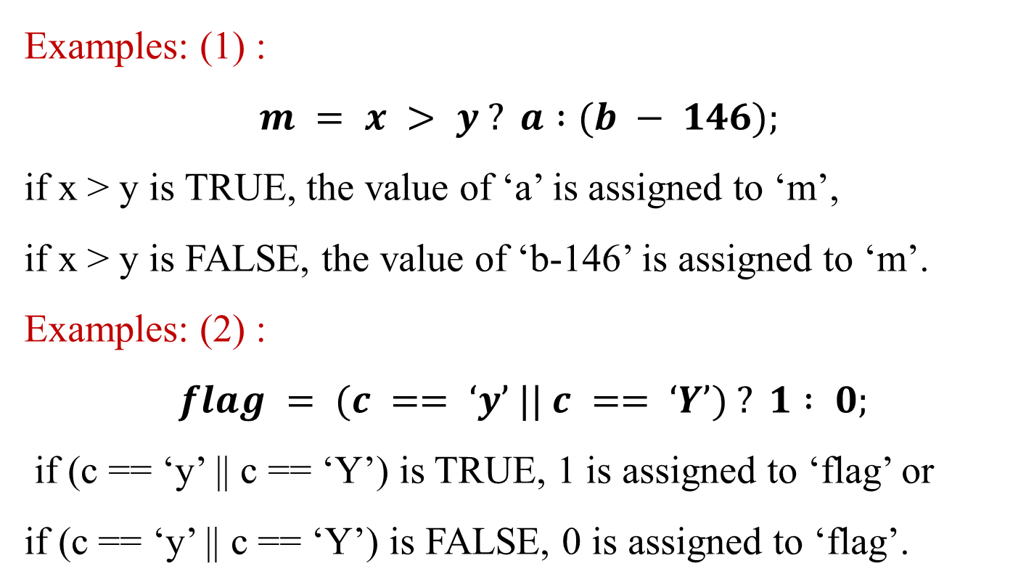
Ternary/Conditional Operator
Examples: (1) :
$$m = x > y ? a :(b − 146);$$
if x > y is TRUE, the value of ‘a’ is assigned to ‘m’,
if x > y is FALSE, the value of ‘b-146’ is assigned to ‘m’.
Examples: (2) :
$$flag = (c == ‘y’ || c == ‘Y’) ? 1 : 0;$$
if (c == ‘y’ || c == ‘Y’) is TRUE, 1 is assigned to ‘flag’ or
if (c == ‘y’ || c == ‘Y’) is FALSE, 0 is assigned to ‘flag’.

Slide 19
Ternary/Conditional Operator
Output of the program:
Enter two integer numbers: 23 56
a = 23 b = 56
Maximum of a and b is 56
Minimum of a and b is 23
/*** THE USE OF CONDITIONAL OPERATOR ***/
#include<stdio.h>
int main()
{
int a,b,min,max;
printf(“\n\nEnter two integer numbers:”);
scanf(“%d %d”,&a,&b);
printf(“\n\na = %d b = %d”,a,b);
max = a > b ? a : b;
min = a < b ? a : b;
printf(“\n\nMaximum of a and b is %d”,max);
printf(“\nMinimum of a and b is %d”,min);
return 0;
}

Slide 20
Special Operators
The sizeof() operator returns the size (number of bytes) of the operand.
The operand may be a constant, variable or any valid data-type.
The operand is written within the parentheses of the sizeof operator.
It is commonly used to determine the lengths of arrays and structures.

Slide 21
Special Operators
The sizeof() operator returns the size (number of bytes) of the operand.
It is also used to allocate memory space dynamically to variables during the execution of the program.
Examples:
a = sizeof (int);
y = sizeof (avg);

Slide 22
/**** USE OF SIZEOF() OPERATOR ****/
Output of the program:
Size of x = 2
Size of y = 4
Size of ch = 1
Size of double = 8
#include <stdio.h>
int main()
{
int x;
float y;
char ch = 'y';
x = 10;
y = 100.0;
printf("\n\nSize of x = %zu", sizeof(x));
printf("\nSize of y = %zu", sizeof(y));
printf("\nSize of ch = %zu", sizeof(ch));
printf("\nSize of double = %zu", sizeof(double));
return 0;
}

Slide 23

The Comma Operator
The comma operator can be used to link the related expressions together.
A comma linked list of expressions are evaluated left to right and the value of the right most expression is the value of the combined expression.
Examples:
$$(1) value = (x = 10, y = 5, x+y);$$
First assigns the value 10 to x, then assigns 5 to y, and finally assigns 15 (i.e., 10+5) to value.
The comma operator is also used to exchange the values stored in two memory locations.
$$(2) temp = a, a = b, b = temp;$$

Slide 24
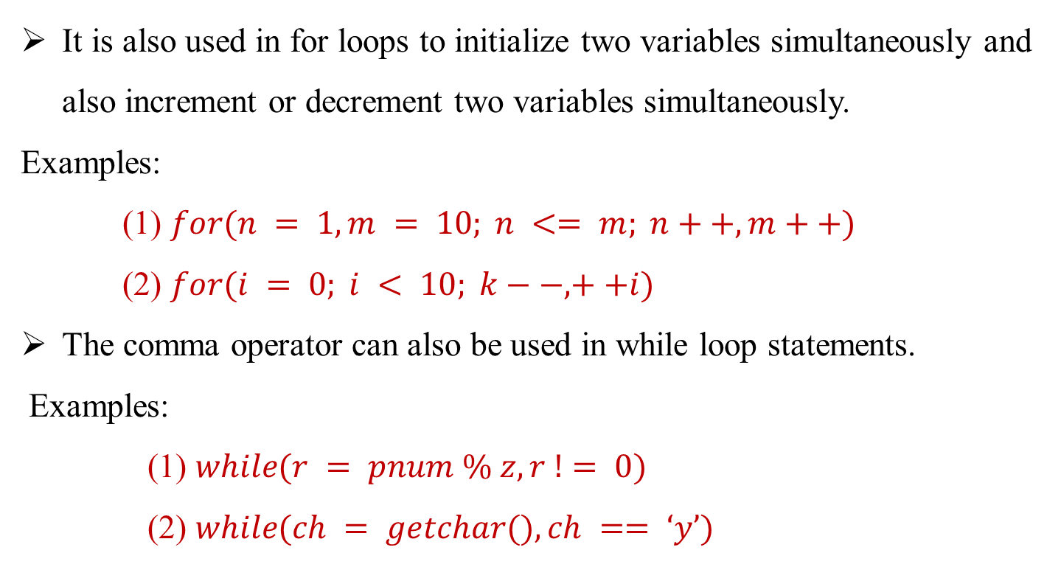
The Comma Operator
It is also used in for loops to initialize two variables simultaneously and also increment or decrement two variables simultaneously.
Examples:
(1) $for(n = 1, m = 10; n <= m; n++, m++)$
(2) $for(i = 0; i < 10; k−−, ++i)$
The comma operator can also be used in while loop statements.
Examples:
(1) $while(r = pnum \% z, r != 0)$
(2) $while(ch = getchar(), ch == ‘y’)$

Slide 25
/**** USE OF COMMA OPERATOR ****/
#include int main()
{
int a,b,temp;
b = (a = 20,a + 10);
printf(“\n\nBefore swapping, a = %d & b = %d”,a,b);
temp = a, a = b, b = temp;
printf(“\nAfter swapping, a = %d & b = %d”,a,b);
return 0;
}
Output of the program:
Before swapping, a = 20 & b = 30
After swapping, a = 30 & b = 20

Slide 26
Shorthand Assignment Operators
Shorthand assignment operators associated with arithmetic operations have already been seen.
The bitwise operators can also be written in shorthand form.
The shorthand arithmetic operators and bitwise operators:

Slide 27
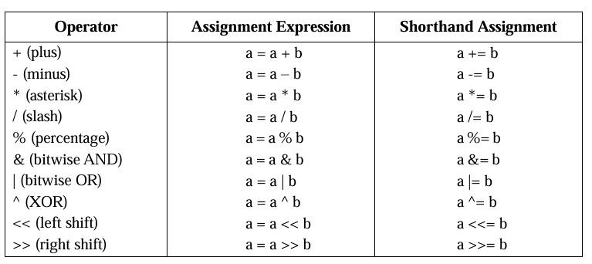
Shorthand Assignment Operators

Slide 28
C EXPRESSIONS
Expressions are basically operators acting on operands.
There are rules that govern how the expression gets interpreted by the compiler.
Such expressions follow C’s precedence and associativity rules.
The precedence of operators determine a rank for the operators.

Slide 29
Precedence and Associativity
Operator | Description | Associativity | Precedence
+ - ++ -- ! ~ * | Unary plus Unary minus Increment Decrement Logical negation Ones complement Pointer reference | R to L | 1
& sizeof() (type) | Address Size of an object Type cast (conversion) | L to R
() [] | Function call Array references | L to R | 2
* / % | Multiplication Division Modulus | L to R | 3
+ - | Addition Subtraction | L to R | 4
<< >> | Bitwise left shift Bitwise right shift | L to R | 5

Slide 30
Precedence and Associativity
Operator | Description | Associativity | Precedence
< <= > >= | Less than Less than or equal to Greater than Grater than or equal to | L to R | 6
== != | Equal to Not equal to | L to R | 7
& | Bitwise AND | L to R | 8
^ | Bitwise XOR | L to R | 9
| | Bitwise OR | L to R | 10
&& | Logical AND | L to R | 11
|| | Logical OR | L to R | 12
? : | Conditional expression | L to R | 13
= *= /= %= += -= &= ^= |= <<= >>= | Assignment operators | R to L | 14
, | Comma operator | R to L | 15

Slide 31
OPERATOR PRECEDENCE AND ASSOCIATIVITY
The operator precedence and associativity rules specifies the order in which operators in an expression are bound to the operands.
Precedence of Operators:
The order in which different operators are used to evaluate an expression is called precedence of operators or hierarchy of operators.
The operators are evaluated from highest precedence to least precedence.

Slide 32
OPERATOR PRECEDENCE AND ASSOCIATIVITY
Associativity of Operators:
Whenever two or more operators having the same precedence or priority occurs in the expression, then the direction order chosen (left to right or right to left ) to evaluate an expression is called associativity of operators.

Slide 33
They are classified into two categories based on the direction
of evaluation chosen as below:
Left to Right Associativity:
Here the direction order chosen for evaluation is left to right.
Eg: Arithmetic operators, Logical Operators and Relational operators follows left to right associativity.
Right to Left Associativity:
Here the direction order chosen for evaluation is right to left.
Eg: Assignment operator, unary operators and conditional expression, etc., have right to left associativity.

Slide 34
PRECEDENCE OF ARITHMETIC OPERATORS
An arithmetic expression without parenthesis will be
evaluated from left to right using the rules of precedence
of operators.
There are two distinct priority levels of arithmetic
operators in C:
High priority * / %
Low priority + -

Slide 35
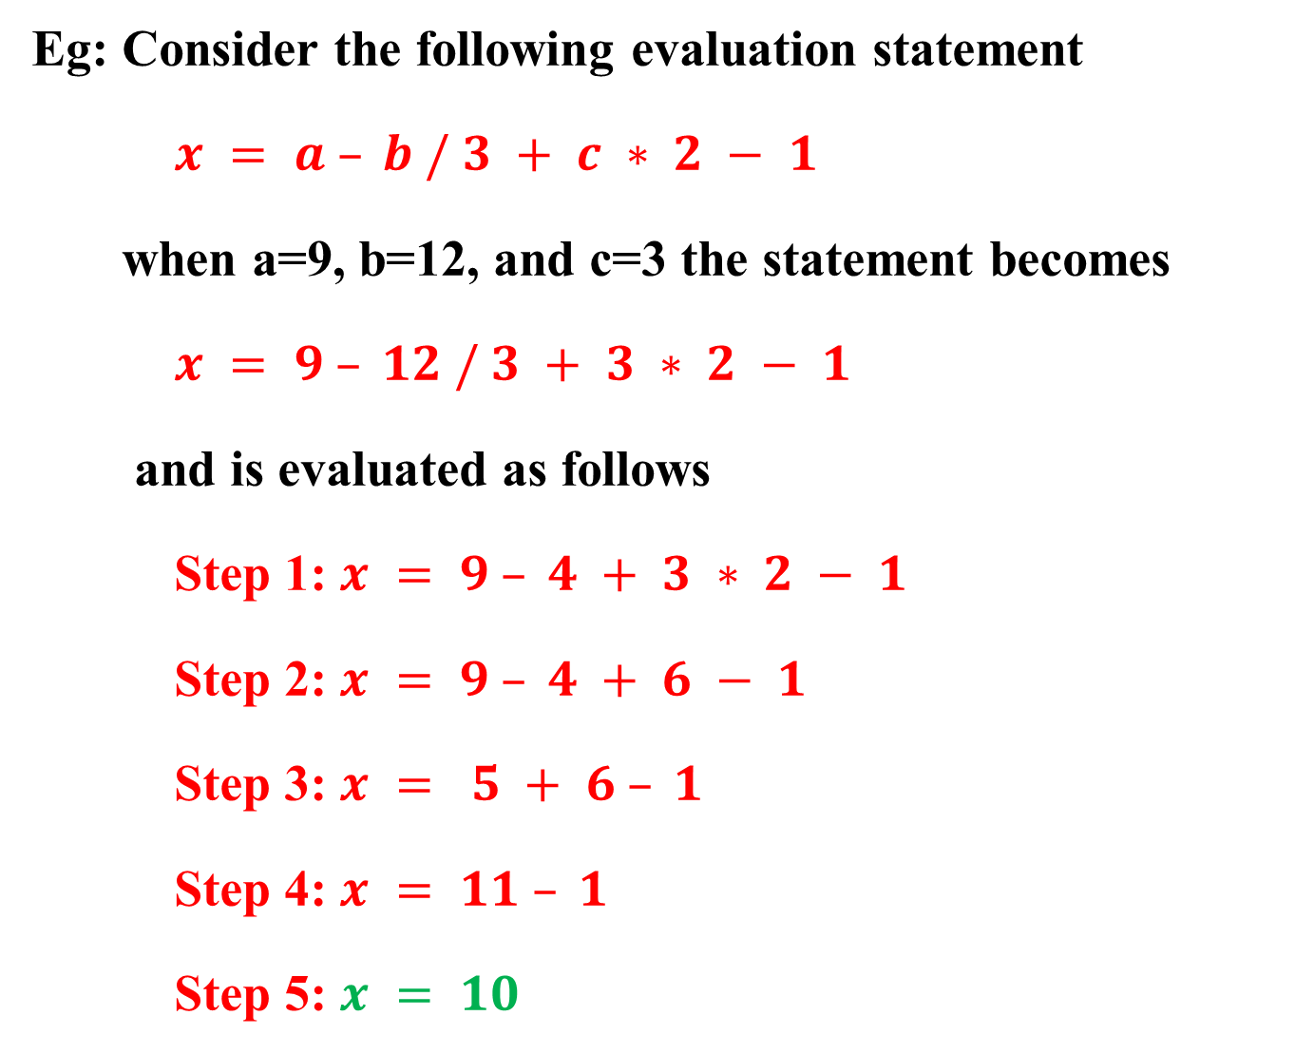
Eg: Consider the following evaluation statement
$x = a – b / 3 + c ∗ 2 − 1$
when a=9, b=12, and c=3 the statement becomes
$x = 9 – 12 / 3 + 3 ∗ 2 − 1$
and is evaluated as follows
Step 1: $x = 9 – 4 + 3 ∗ 2 − 1$
Step 2: $x = 9 – 4 + 6 − 1$
Step 3: $x = 5 + 6 – 1$
Step 4: $x = 11 – 1$
Step 5: $x = 10$

Slide 36
Operators | Priority
! | 1
&& | 2
|| | 3
Eg1:
C = 2 && 5 || !6
C = 2 && 5 || (!6)
C = (2 && 5) || 0
C = 1 || 0
C = 1
Eg2:
12 && 5 && 4 || 3 || !0
12 && 5 && 4 || 3 || (!0)
(12 && 5) && 4 || 3 || 1
(1&& 4) || 3 || 1
(1 || 3) || 1
1 || 1
1

Slide 37
Opereators | Priorities
! | 1
*, /, % | 2
+, - | 3
<, <=, >, >= | 4
!=, == | 5
& | 6
^ | 7
| | 8
&& | 9
|| | 10
Eg3:
11 + 2 > 6 && !0 || 11 != 7 && 11 – 2 <= 5
11 + 2 > 6 && (!0) || 11 != 7 && 11 – 2 <= 5
(11 + 2) > 6 && 1|| 11 != 7 && 11 – 2 <= 5
13> 6 && 1 || 11 != 7 && (11 – 2) <= 5
(13> 6) && 1 || 11 != 7 && 9<= 5
1&& 1 || 11 != 7 && (9<= 5)
1 && 1 || (11 != 7) && 0
(1 && 1) || (1 && 0)
1 || 0
1

Slide 38
Type Conversion In C
The process of converting one type of data type to another, say change int to float or float to int is known as data type conversion or type casting.
The general form of type casting is
(data type)variable
Example
int a = 3;
float sum;
sum = 20/a;
Value of ‘sum’ is 6.00000
int a = 3;
float sum;
sum = 20/(float)a;
Value of ‘sum’ is 6.666666
Data type conversion can be done in two ways:
1. Implicit type conversion
2. Explicit type conversion

Slide 39
Implicit type conversion
This type of conversion is usually performed by the compiler when necessary without any commands by the user.
Thus it is also called "Automatic Type Conversion".
The compiler usually performs this type of conversion when a particular expression contains more than one data type.
The compiler first performs integer promotion; if the operands still have different types, then they are converted to the type that appears highest in the following hierarchy.

Slide 40
low
Conversion hierarchy
high
long double
double
float
unsigned long int
long int
unsigned int
int
short
char

Slide 41
Example:
#include <stdio.h>
int main() {
int i = 17;
char c = 'c'; /* ASCII value is 99 */
float sum;
sum = i + c;
printf("Value of sum: %f\n", sum);
return 0;
}
Output:
Value of sum : 116.000000

Slide 42
Explicit type conversion:
In Explicit type conversion, the user explicitly defines within the program the datatype, to which the operands/variables of the expression need to be converted.
#include <stdio.h>
int main() {
double a = 4.5;
double b = 4.6;
double c = 4.9;
int result;
result = (int)a + (int)b + (int)c; // Explicitly casting double to int
printf("Result = %d\n", result);
return 0;
}
Output: Result = 12

